Slide 1
INTRODUCTION

Slide 2
This website has been created for making the functioning of a society/association easy
Due to the COVID-19 pandemic ,social gatherings are not possible and therefore processes like collection of money,registering complaints of society members,taking suggestions,managing expenditures of society can’t be performed.
But these processes are important for functioning of a society and hence can’t be stopped.
This website gives solution to this problem by providing an online platform to carry out processes like these

Slide 3
The website has the following functionalities :
The users can register their complaints about anything to the admin.
The users can give suggestions about anything .
the users can make the payments online using this website .
the users can also maintain track of their complaints and suggestions so that they know whether required actions were taken or not.
the users can also track the expenses of the society which makes the process really tarnsparent because now the society members can see where and how the money is being spent.
there’s a notification section as well where the society members can see all the important notifications.

Slide 4
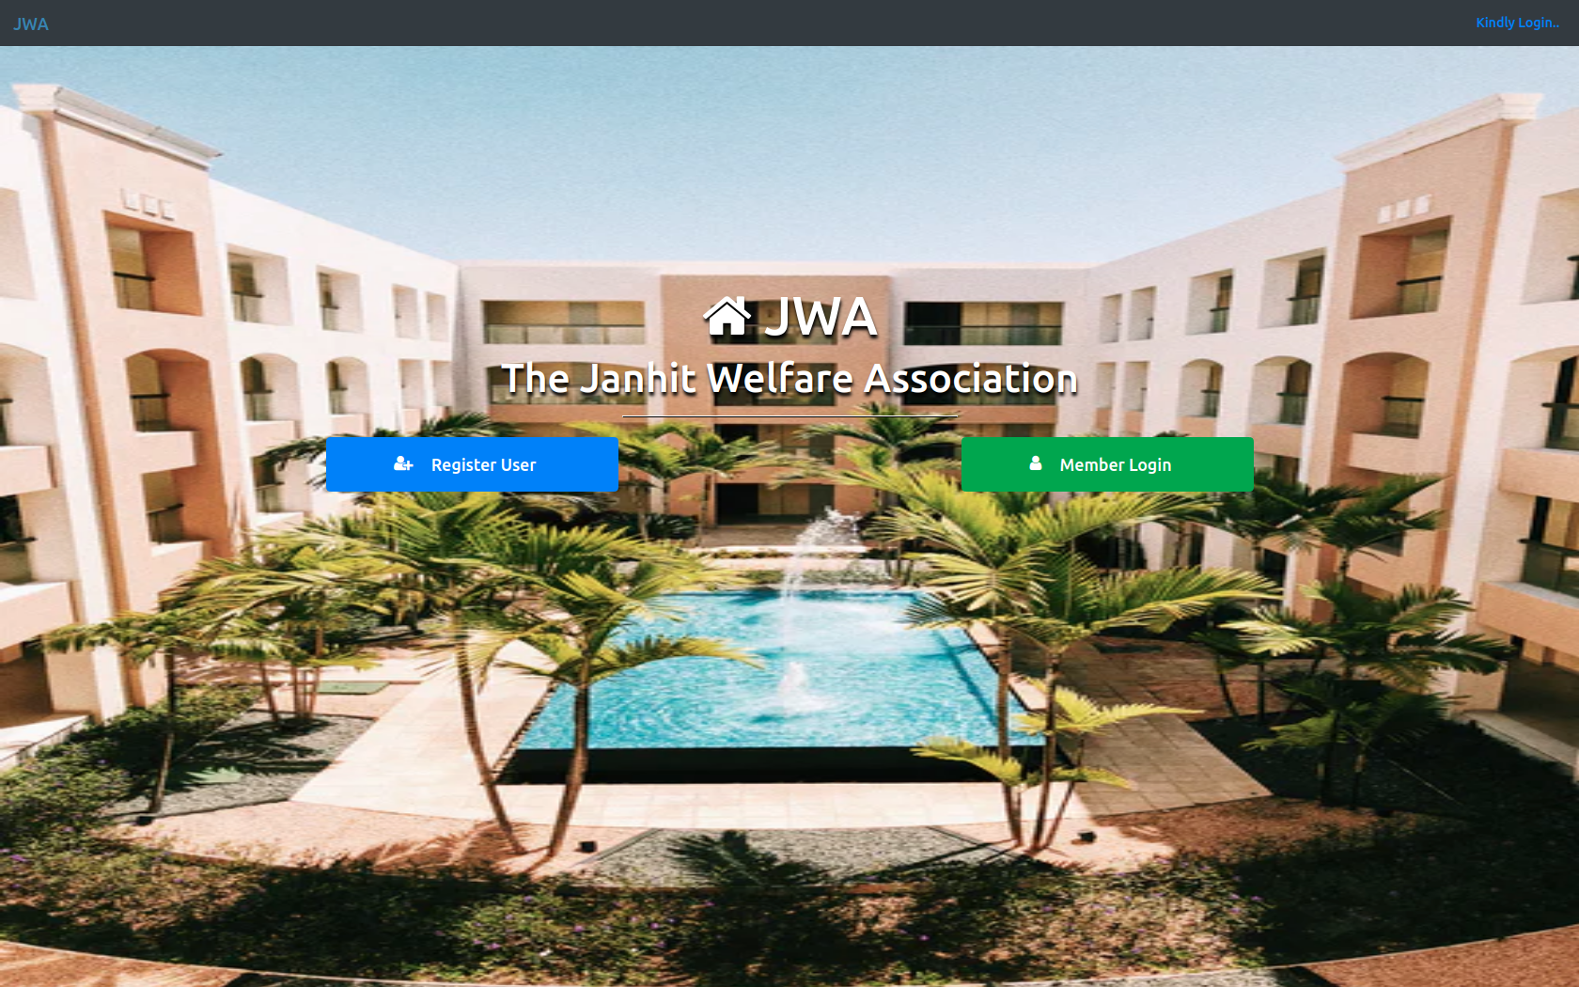
HOME PAGE

Slide 5

Home Page in which there is a navbar at the top of it and at the middle 3 buttons are there:
Register user: For registering for society.
User Login: Login for society members.

Slide 6
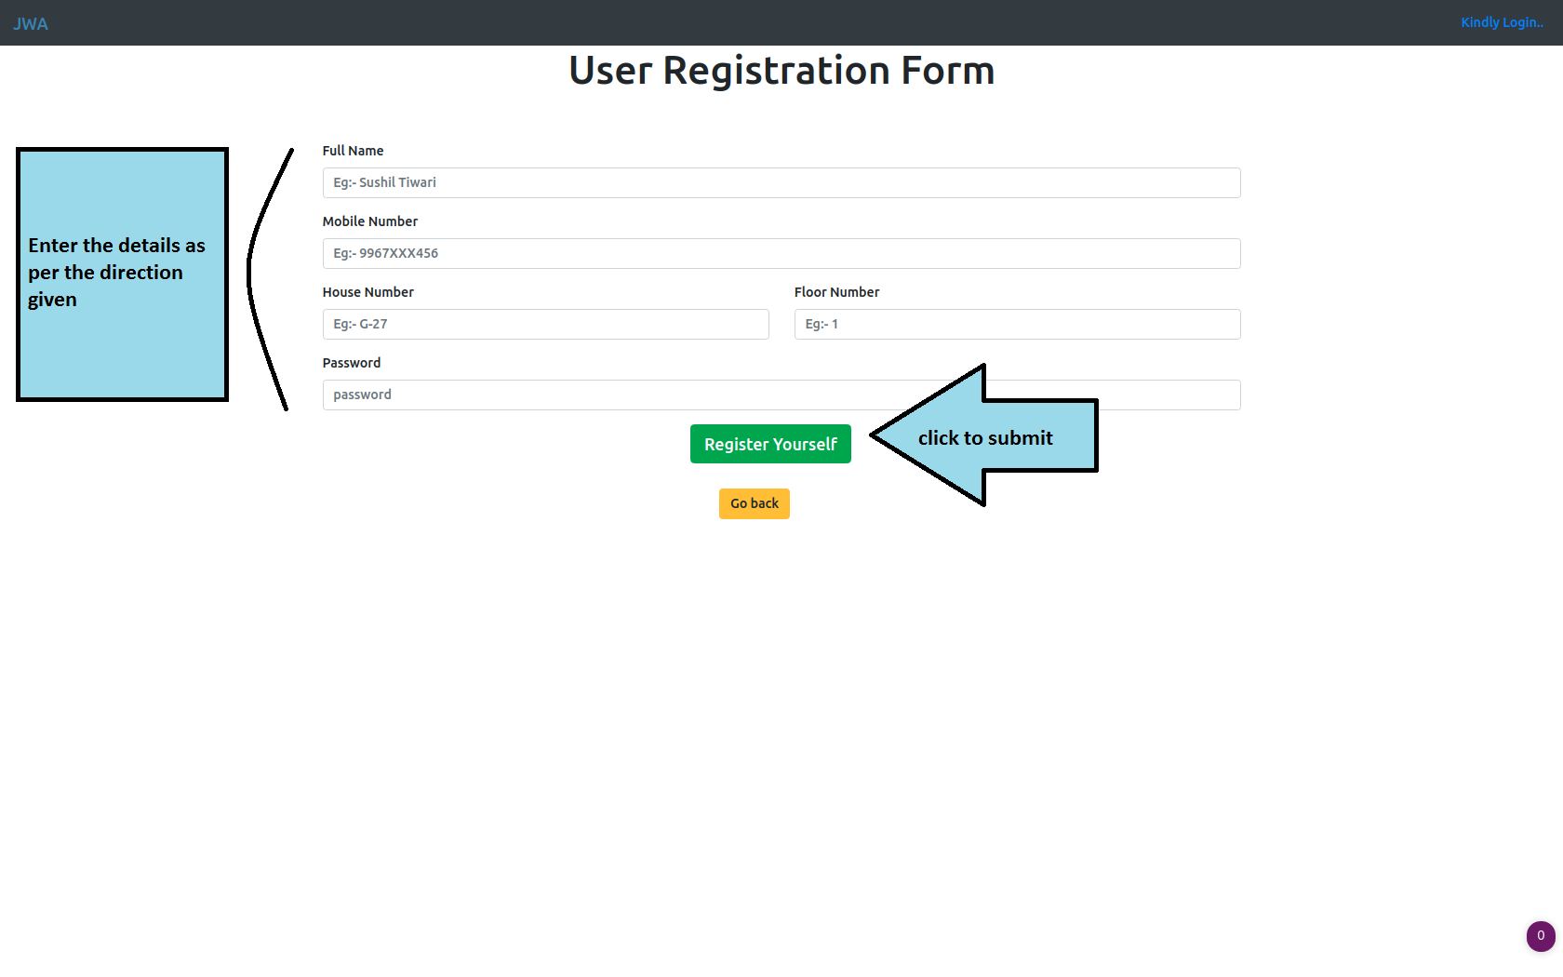
User Registration
Enter all the details and click on register yourself to get registered for society

Slide 7
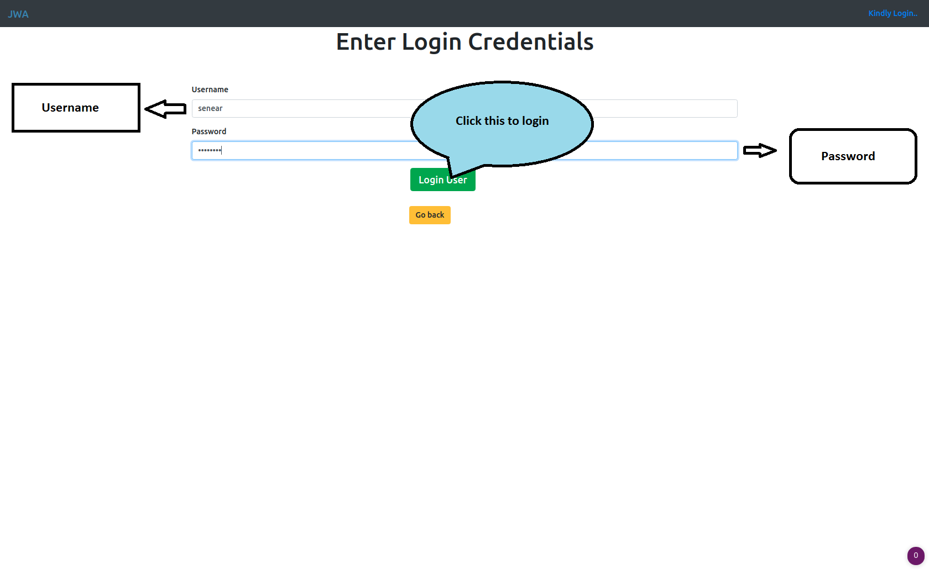
MEMBER LOGIN
Here member has to enter his/her username and password and then click submit(blue button) to open user’s dashboard.

Slide 8
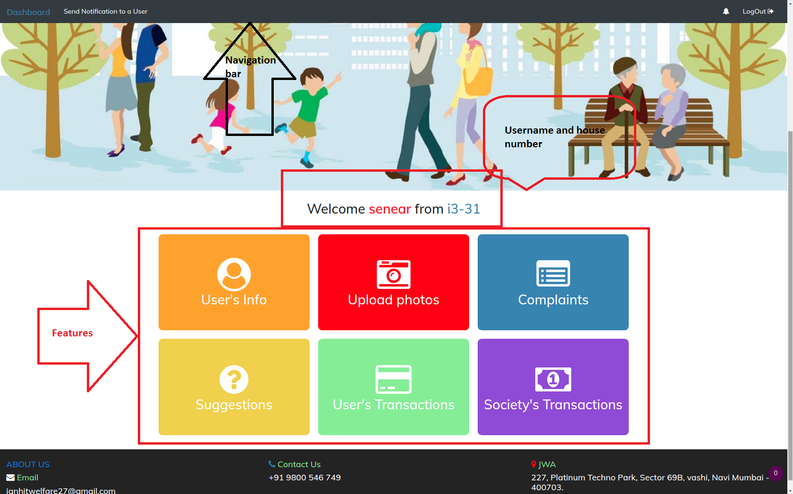
DASHBOARD of USER’S LOGIN

Slide 9
User info: Contains all the information about user .
Upload photo: Uploads photo to society’s gallery.
Complaint: Use to file complaint to a user or to admin.
Suggestions: Suggest diiferent things for the betterment of society.
User’s transactions: Clicking on this take you to payment page to pay for society’s maintenance or anything else.
Society’s transactions: This page shows all the transaction done by society and how much balance is left.

Slide 10
This is the navigation bar of user login page . It contains four options as follows:
Dashboard : List of various options like user info, transactions etc.
Send Notification to user: Helps to send message to a particular user.
Notification bell : Redirects you to a page where you can see various notices.
Logout : Helps in logging out your page.

Slide 11
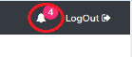
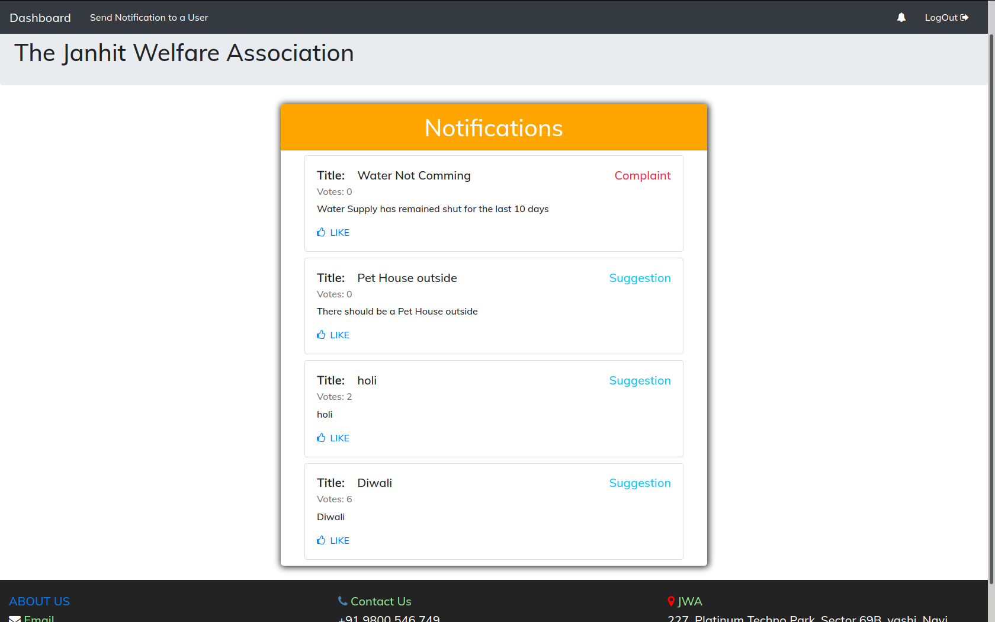
This is notification section in which user can see different notices regarding events ,changes ,payment dues etc.

Slide 12
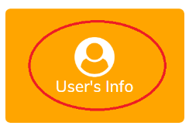
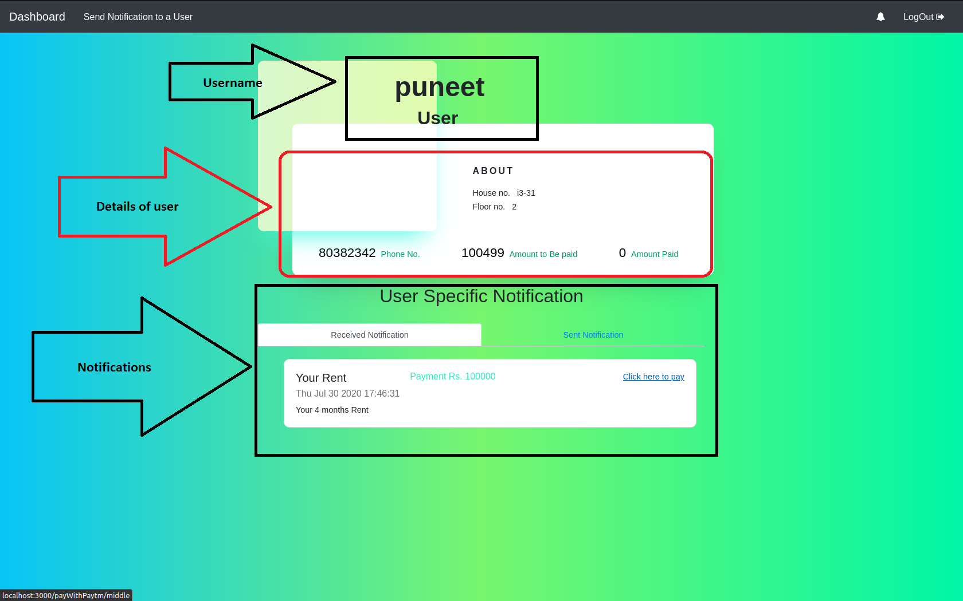
USER’S INFO
This is user’s info in which user details like name ,phone number,house number andsent and received notifications can be seen.

Slide 13
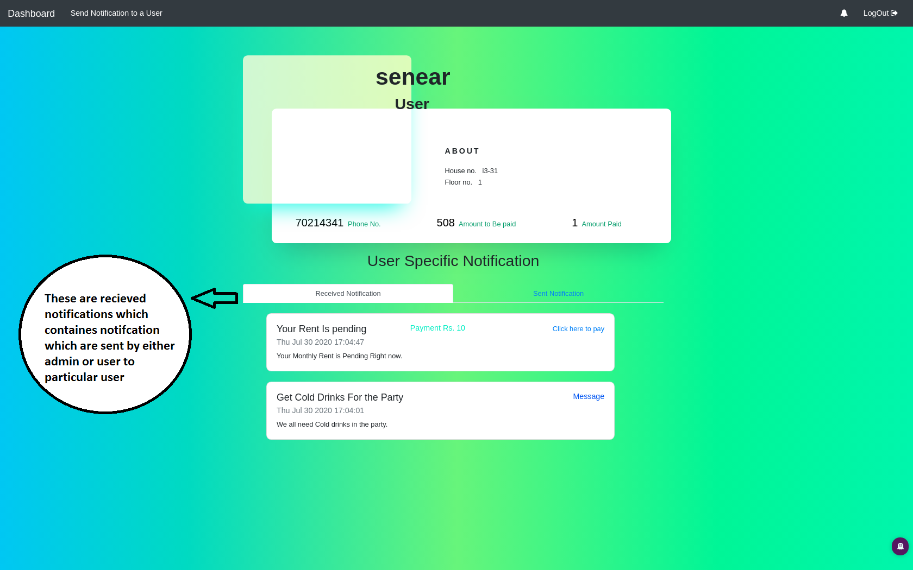

Slide 14
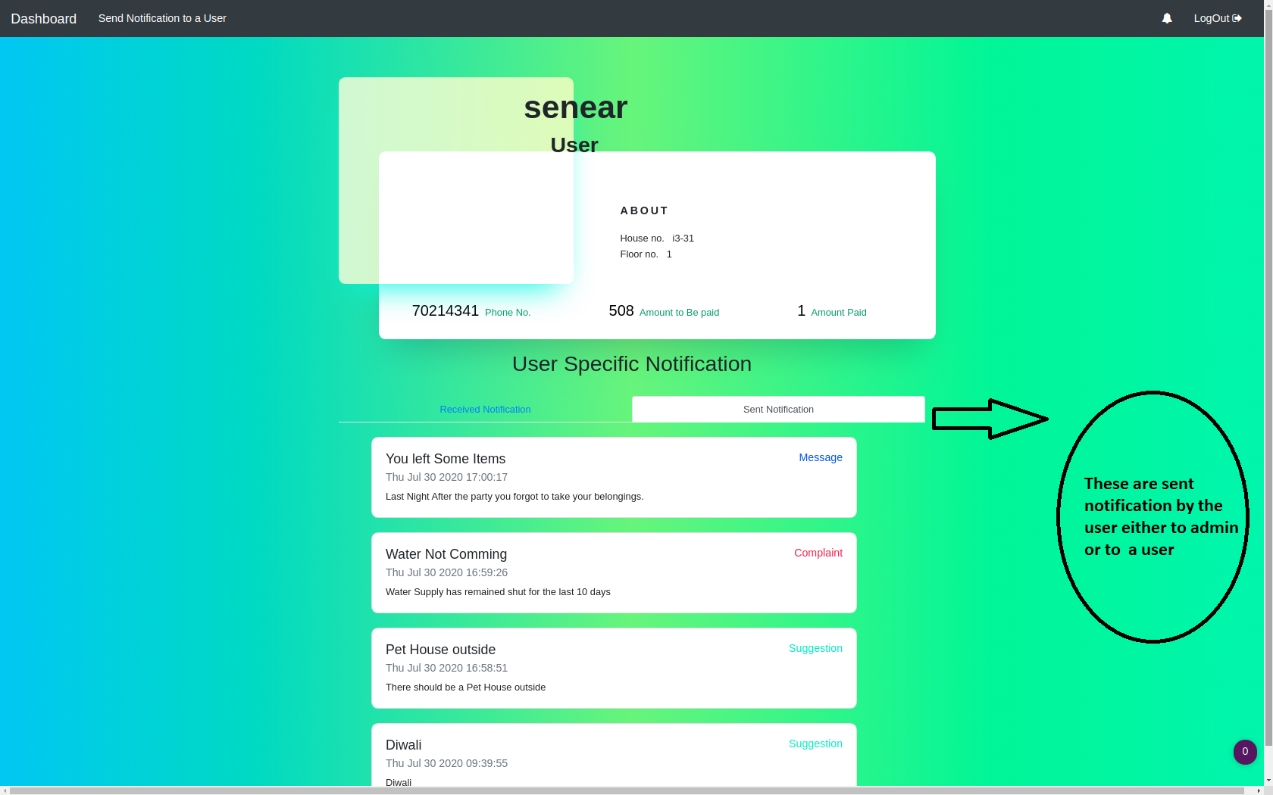

Slide 15

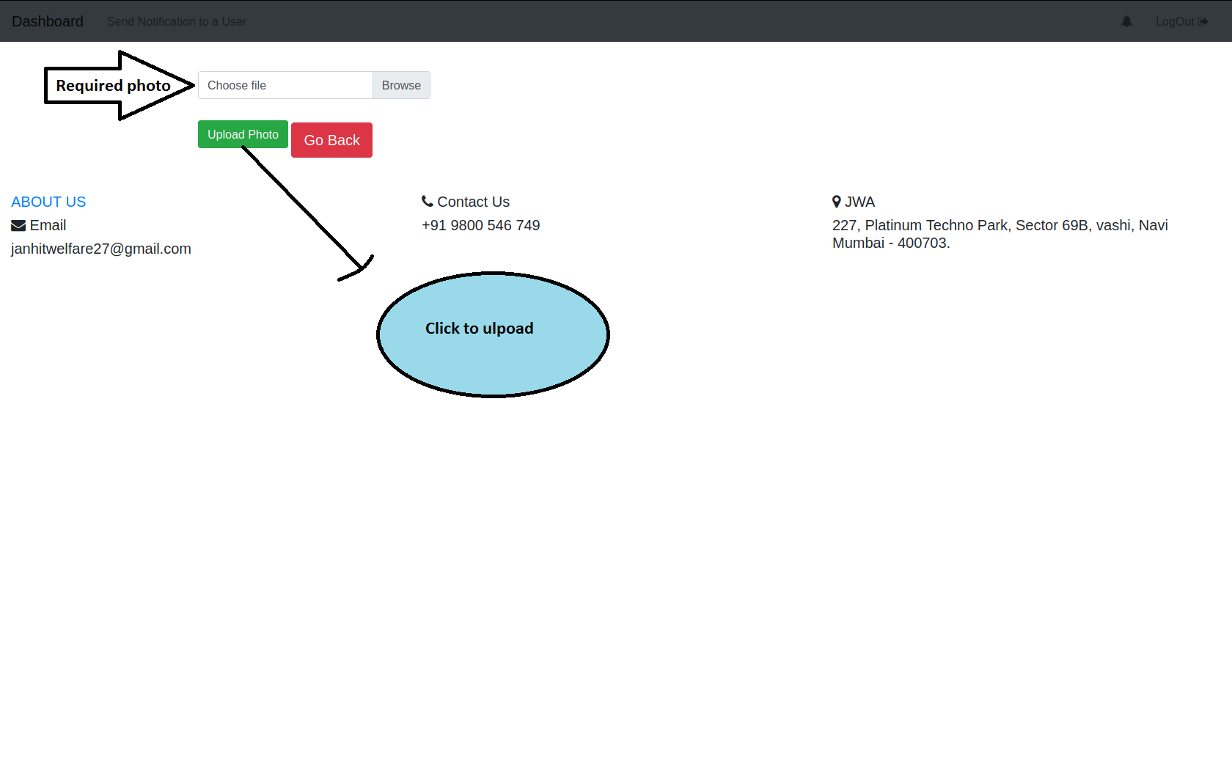
UPLOAD PHOTOS
This is upload photo section which is given so as to have a complete gallery of society .Its main aim is to have records of images which users uploaded and can by seen by all other members.

Slide 16
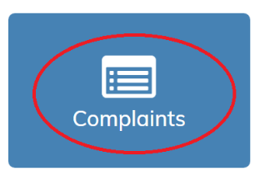
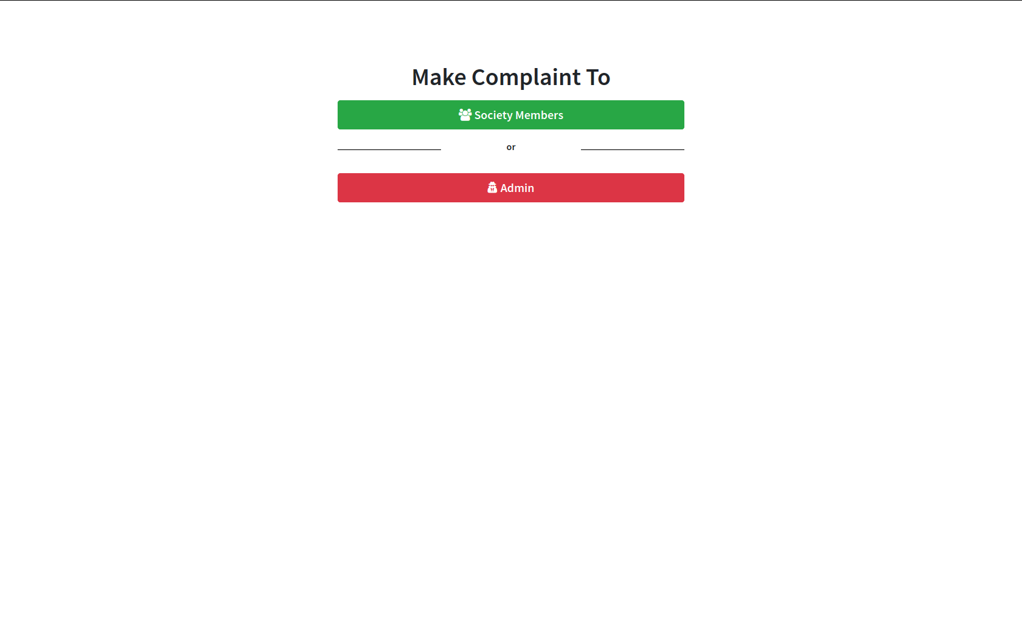
COMPLAINTS
It has two option i.e Complaint To
1. Society members
2. Admin

Slide 17
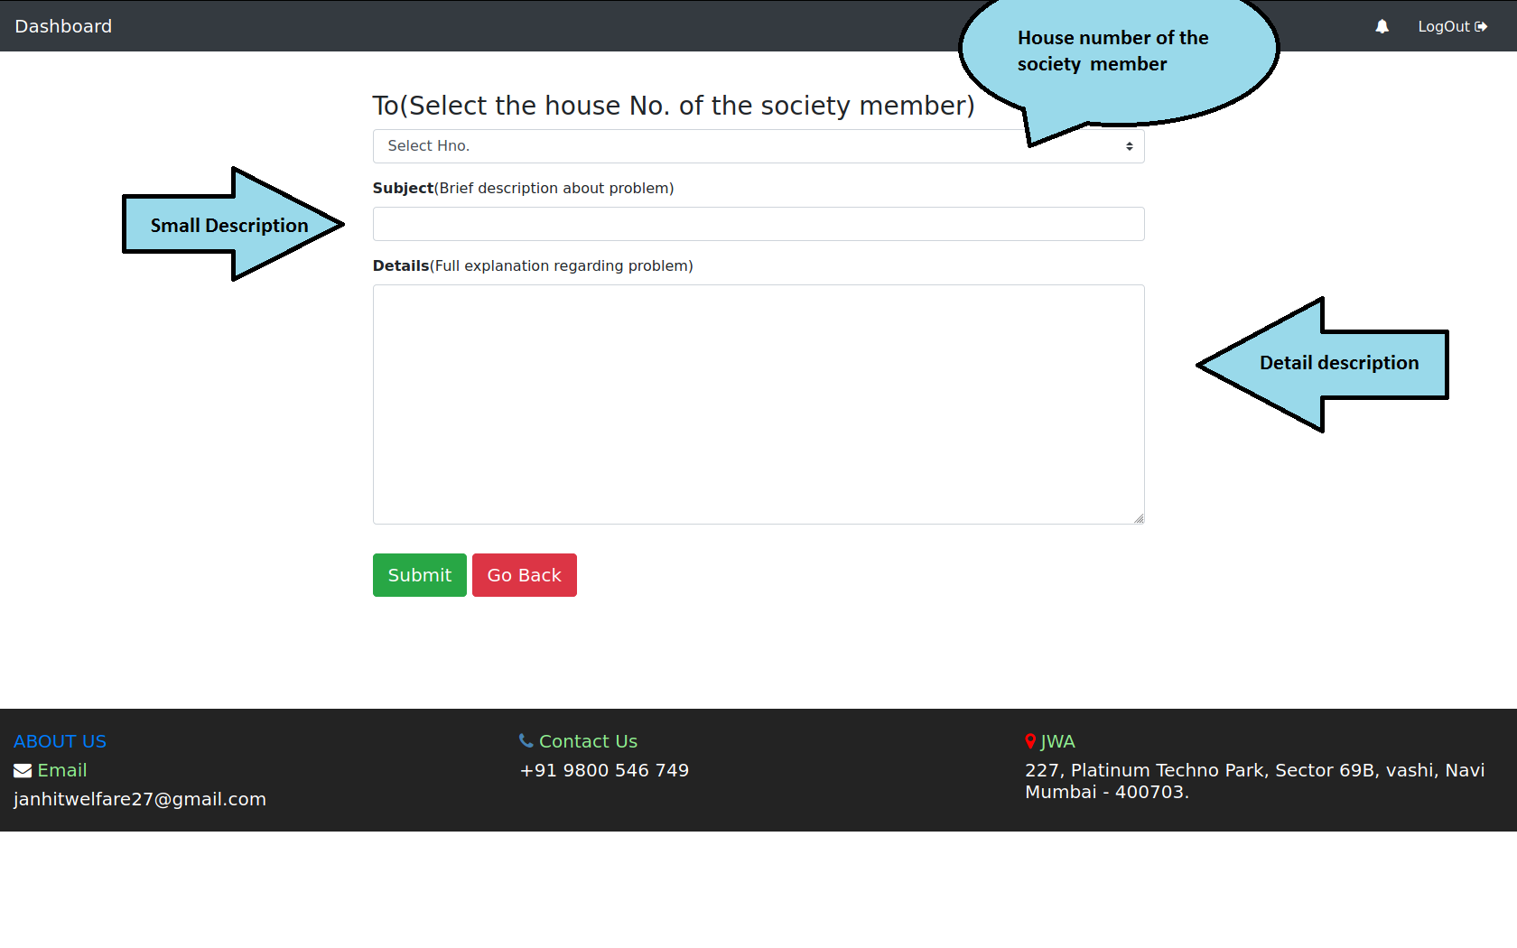
Complaint to society member
It is there to complaint to a particular member without giving other notifications

Slide 18
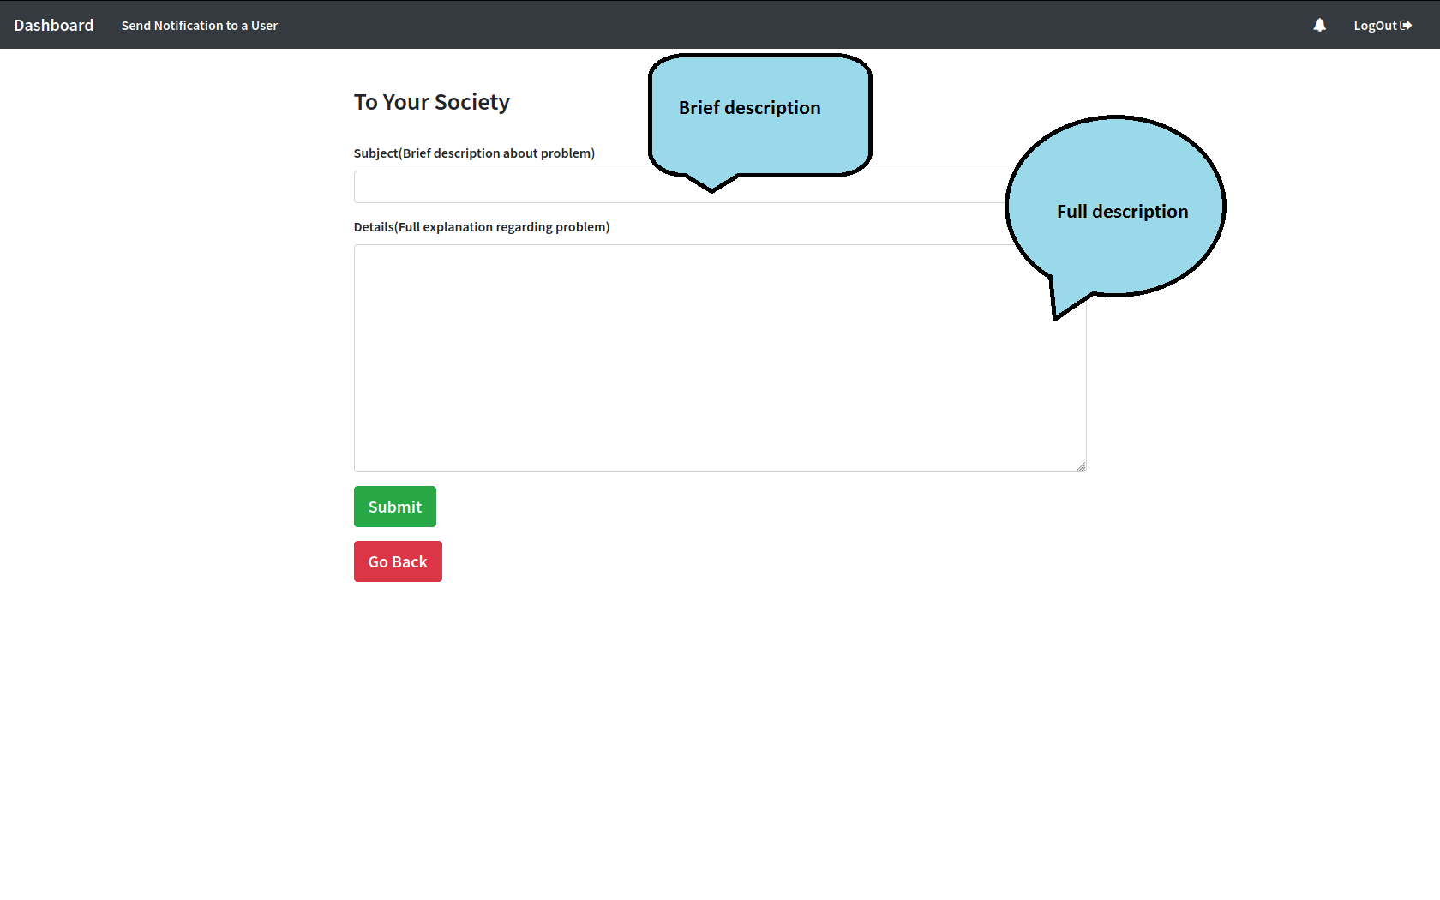
Complaint to Admin
It is there to complaint to a admin without giving other notifications

Slide 19
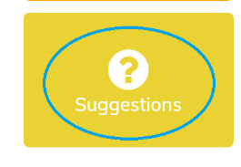
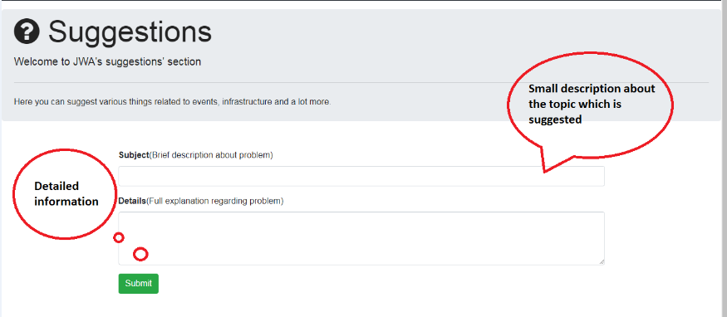
SUGGESTIONS
The image below shows complaint box in which one can write his /her suggestions and then click on submit (red circled area) .

Slide 20
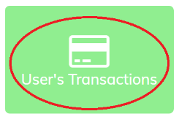
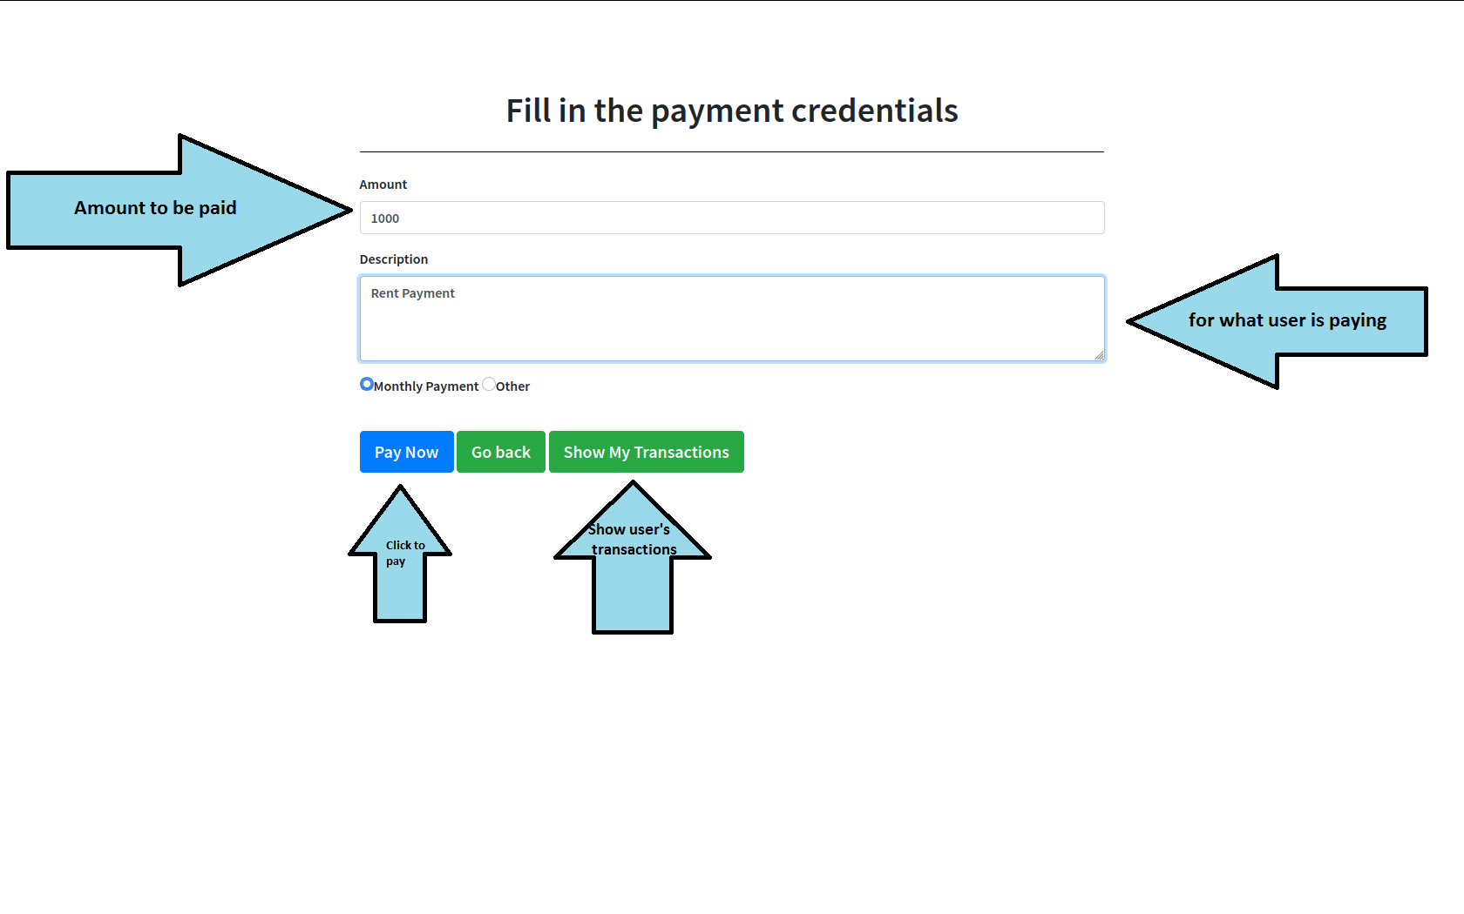
USER’S TRANSACTIONS
Fill all the details as per the direction and click pay now to pay .Clicking on pay now take to you the following page.

Slide 21
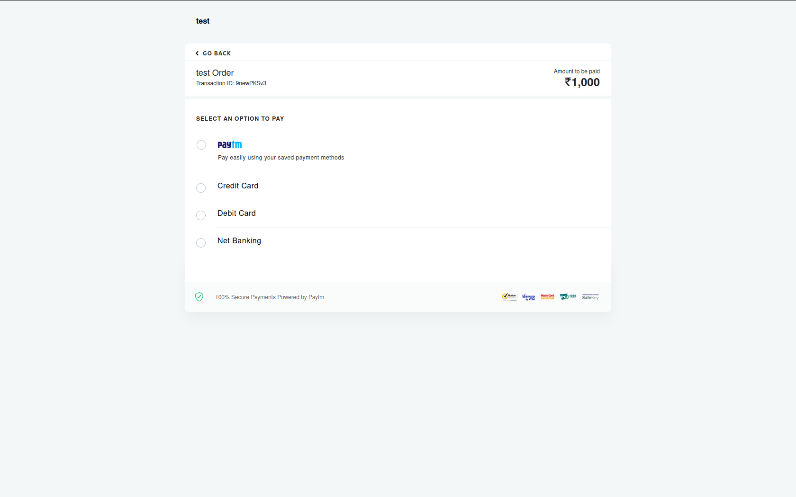
There are four payment options.
Paytm
Credit card
Debit card
Net banking

Slide 22
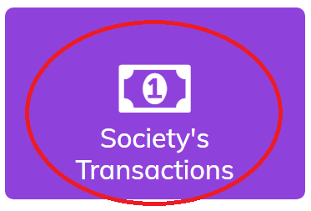
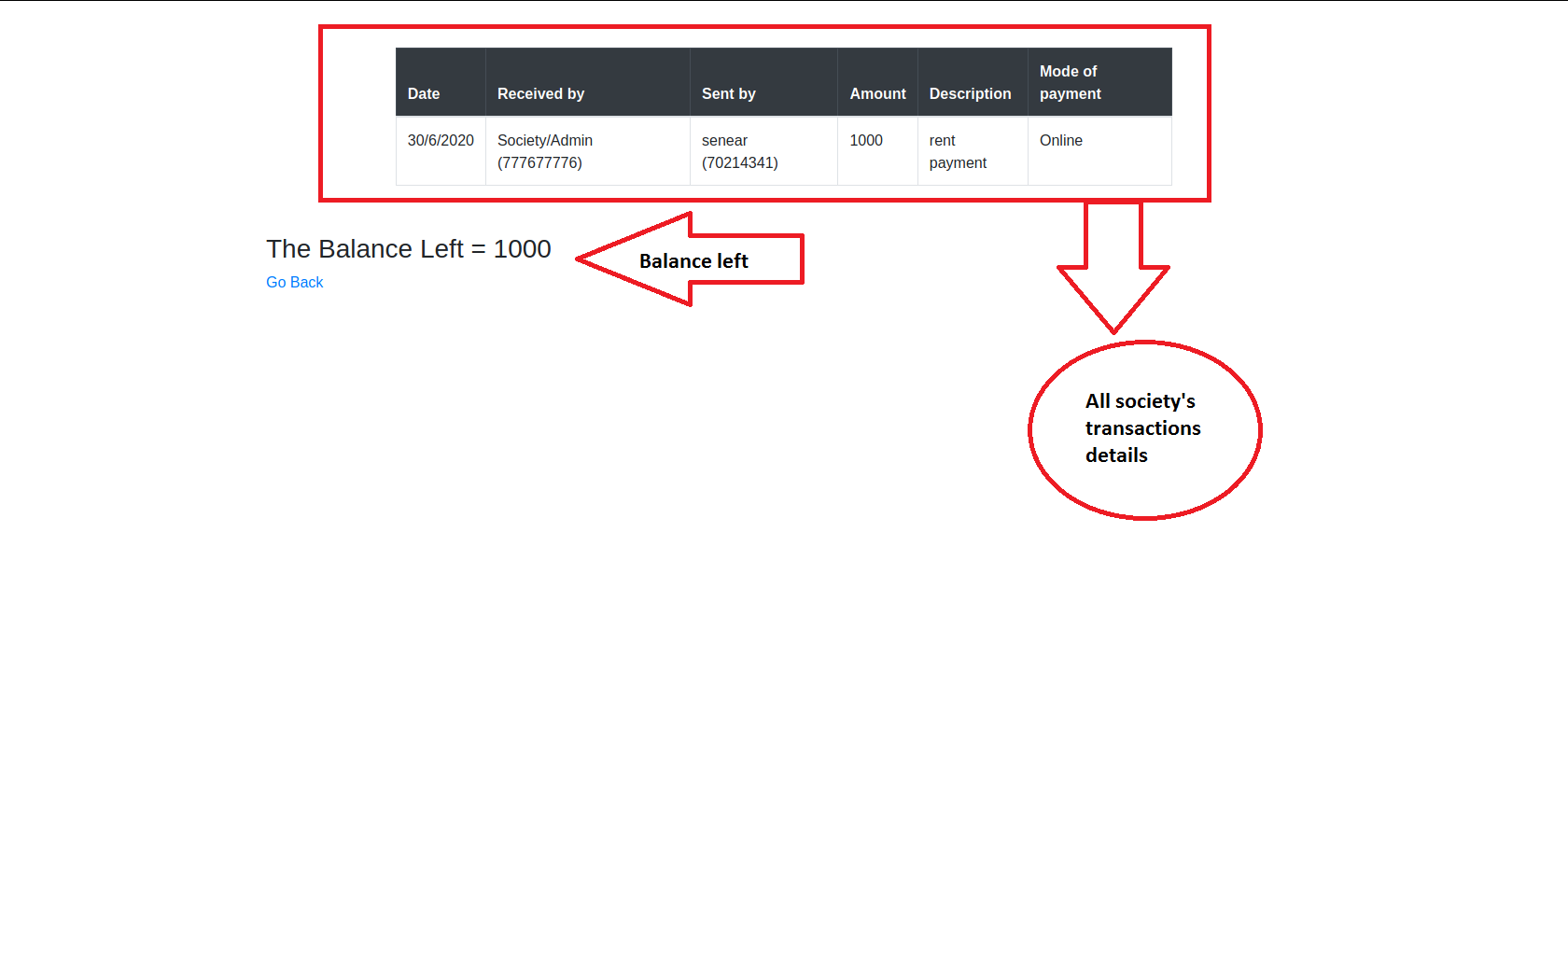
SOCIETY’S TRANSACTIONS
Here members can only see the society transactions i.e. where the society is spending money and how much and how much balance is left.

Slide 23
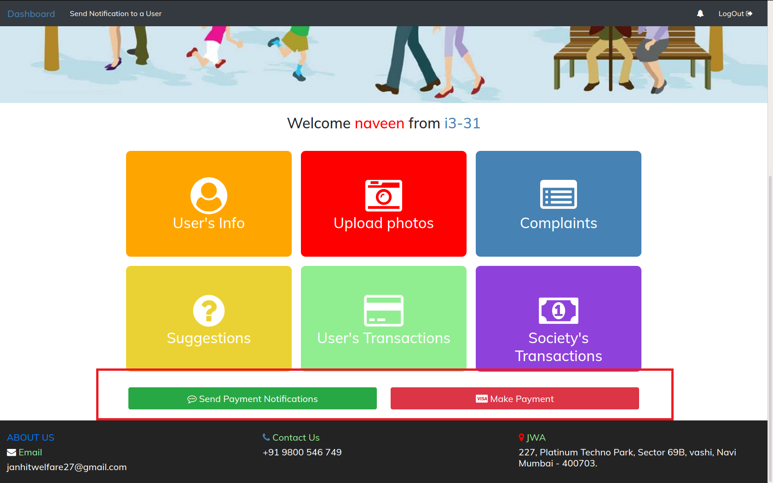
Admin’s Dashboard
All features are same except two more features are added for admin as u can see the red marked area below.
Send payment notification: To send notification to members for payment.
Make payment: To make payment on behalf of the society.

Slide 24
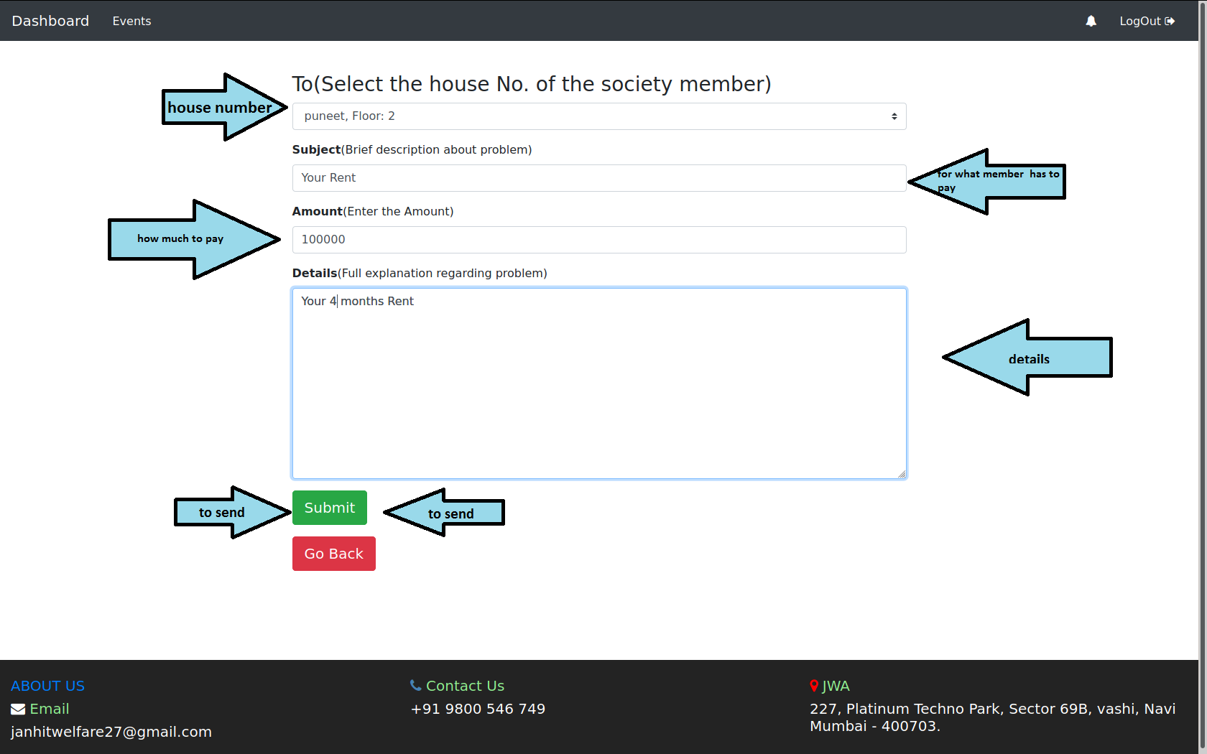
Send Payment Notification
This feature helps admin to send payment notification to users/members.

Slide 25
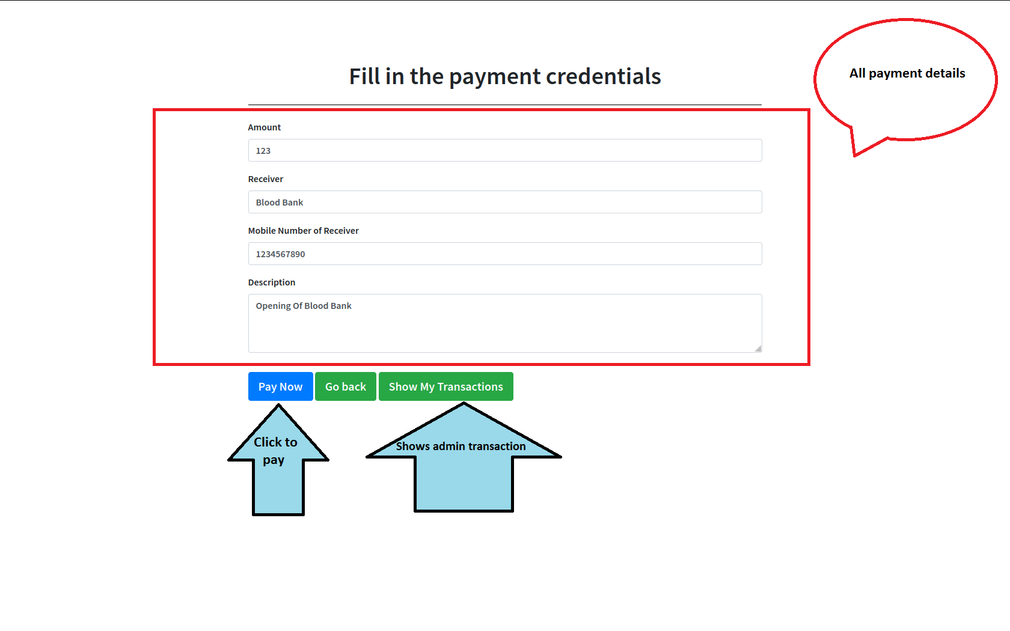
Make Payment
This feature enable admin to spend money collected from members for betterment of society.

Slide 26
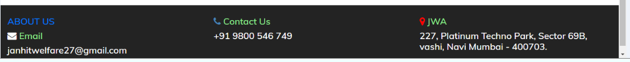
This the footer of page which contain some details regarding society.
Email
Contact details
Location

Slide 27
LIMITATIONS:
Due to the time constraint, below mentioned are the functionalities we could not include in our website:
Sending a common notification to all the society members.
Making payment to all the users simultaneously.
Showing the count of unread notifications of the user on the dashboard.

Slide 28
THE END

